Slide 1




Weekly report: Storage System
12th week – 13th Presentation
Date: 16/12/2025
Supervisor: Dr. Laurence Alhrshy
Presented by :Mohamed Ahmed
16/12/2025
Mohamed Ahmed
Storage System Team/ Optimus Syria

Slide 2
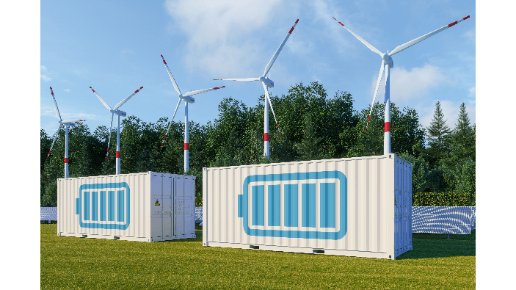
Content
Economic Evaluation
Payback Period Evaluation
Environmental Impact and CO₂ Reduction Potential
References
avaada.com/advantages-of-wind-energy/
16/12/2025
2
Mohamed Ahmed
Storage System Team/ Optimus Syria

Slide 3
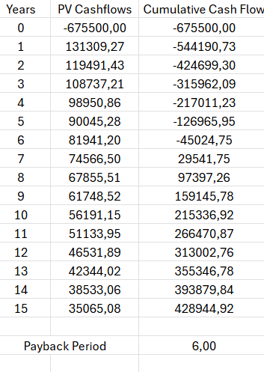
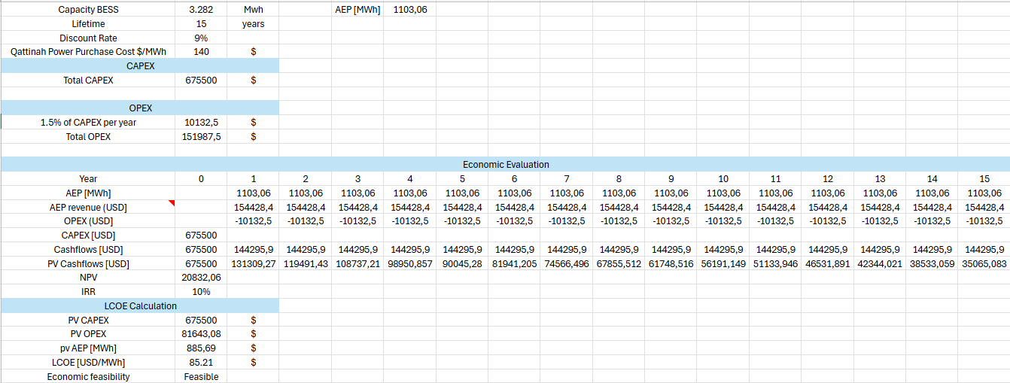
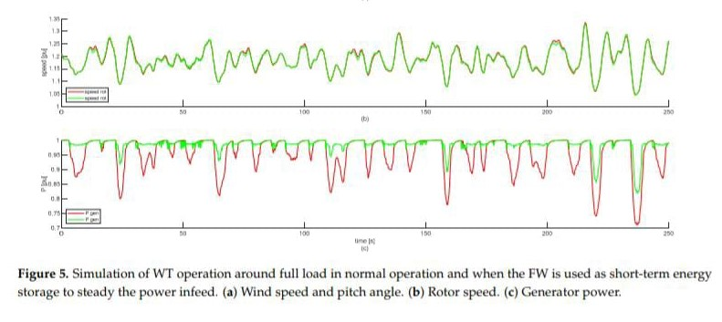
Economic Evaluation
Steadying Power Infeed.
Fast Frequency Response (FFR).
Synthetic / Continuous Inertia Provision.
Low Voltage Ride Through (LVRT).
Power System Stabilization (PSS).
Reduction of Mechanical Loads & Stress.
Support for Emergency Braking & Ramp Control.
16/12/2025
Mohamed Ahmed
Storage System Team/ Optimus Syria

Slide 4
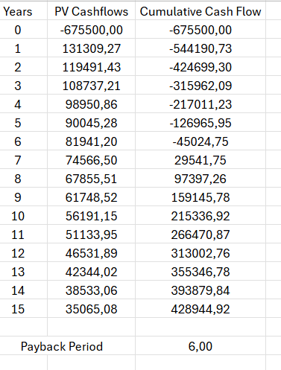
Payback Period Evaluation
Payback Period =
the last year with negative Cf + (Amount of Cf at the end of that year/ Cf during the year after that year)
16/12/2025
Mohamed Ahmed
Storage System Team/ Optimus Syria

Slide 5
Economic Overview
LCOE | 85.81(USD/MWh)
NPV | 20832.06(USD)
IRR | 10%
Economic feasibility | feasible
LCOE: Levelized cost of energy.
NPV: Net present value.
IRR: Internal rate of return.
16/12/2025
Mohamed Ahmed
Storage System Team/ Optimus Syria

Slide 6
Environmental Impact and CO₂ Reduction Potential
  1.Power Sector Emissions
  In 2024, Syria’s power sector emitted approximately 22 million metric tons of CO₂.
  Renewable energy share: Approximately 4.5% of total power generation.
  •Calculation:
  •Total electricity generation = 0.891 TWh (renewables) / 0.045 ≈ 19.8 TWh
  CO₂ emissions per kWh = 22 million metric tons / 19.8 TWh ≈ 1111.1 g CO₂/kWh
  2.Wind Energy Curtailment & Battery Storage Impact
  •Annual Energy Production (AEP): 16,721.96 MWh
  •Annual Curtailment: 6.6% = 1,103.65 MWh/year
  •Curtailment Emissions if Grid-Supplied:
  •CO₂ emissions = 1,103.65 MWh ×1111.11 g CO₂/kWh ≈ 1226.27 metric tons/year
16/12/2025
Mohamed Ahmed
Storage System Team/ Optimus Syria

Slide 7
Environmental Impact and CO₂ Reduction Potential
  •3. Battery System Emissions
  •Battery capacity: 3.2 MWh
  •Battery production emissions: 85 kg CO₂e/kWh (lithium-ion)
  •Calculation:
  •Total emissions from production = 3,020 kWh × 85 kg CO₂e/kWh ≈ 256.7 metric tons
  •4. Total Emissions Impact Over 15 Years
  •Emissions Saved:
  •Total emissions avoided = 1111.11 metric tons/year × 15 ≈ 16,666.65 metric tons
  •Net Emissions Reduction:
  •Net savings = 16,666.65 - 256.7 ≈ 16,409.8 metric tons
16/12/2025
7
Mohamed Ahmed
Storage System Team/ Optimus Syria

Slide 8
Environmental Impact and CO₂ Reduction Potential
  •5. Conclusion:
  •Significant CO₂ Reduction Potential: Despite the emissions from battery production, integrating storage prevents substantial CO₂ emissions over its 15-year lifecycle.
  •Environmental Impact: The system could save over 16,000 metric tons of CO₂ emissions by reducing reliance on the regional grid mix.
16/11/2025
8
Mohamed Ahmed
Storage System Team/ Optimus Syria

Slide 9
References
https://countryeconomy.com/energy-and-environment/electricity-consumption/syria
https://www.worlddata.info/asia/syria/energy-consumption.php
https://en.wikipedia.org/wiki/Energy_in_Syria
25/11/2025
Mohamed Ahmed
Storage System Team/ Optimus Syria
Notes:
Future works ??

